Slide 1



Machine learning techniques for high-throughout analyses of TR-PES measurements
Convolutional Neural Networks employed to fit XPS spectra
Romaric Sallustre, Arthur Julien, Jean-Baptiste Puel, Philip Schulz
22/05/2024

Slide 2
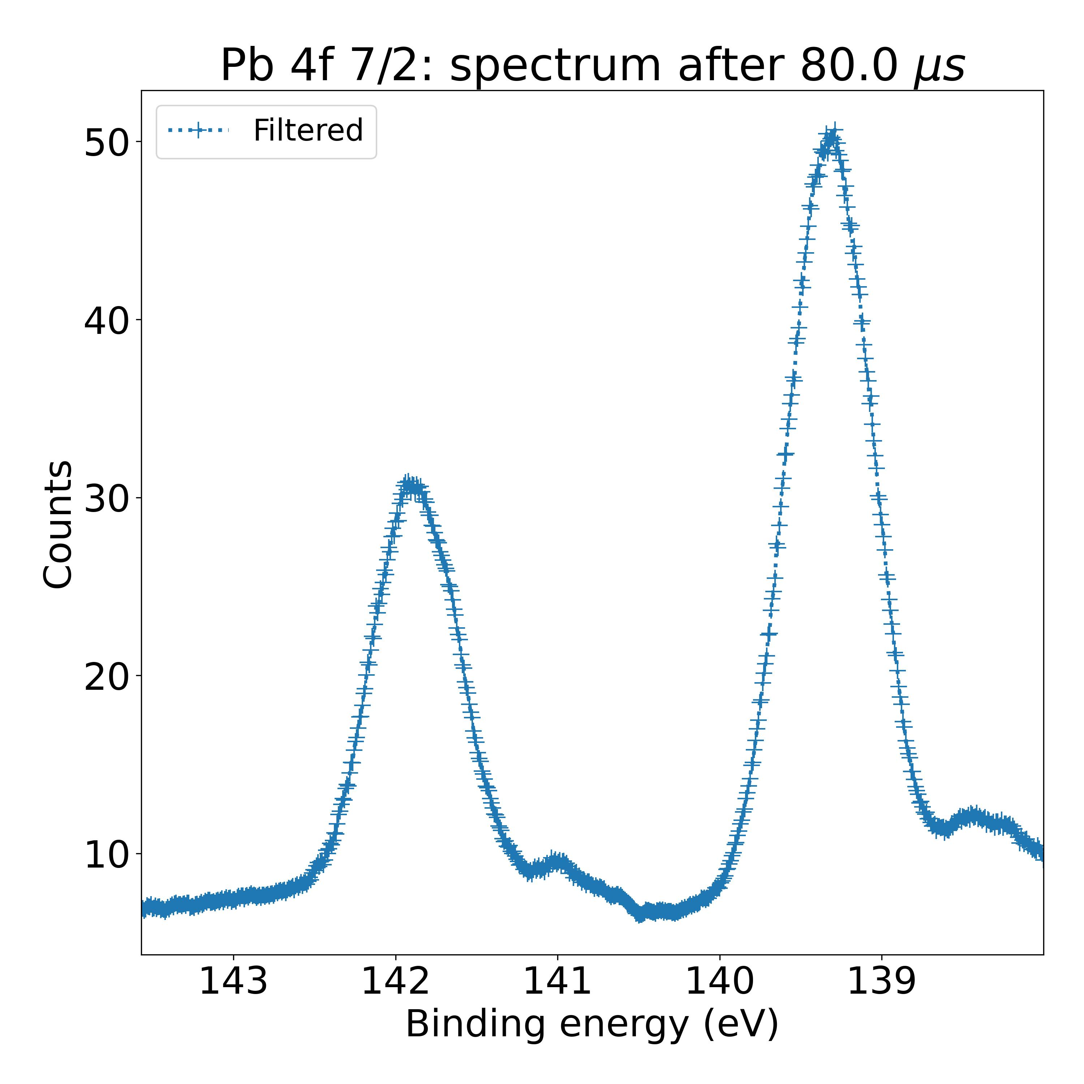
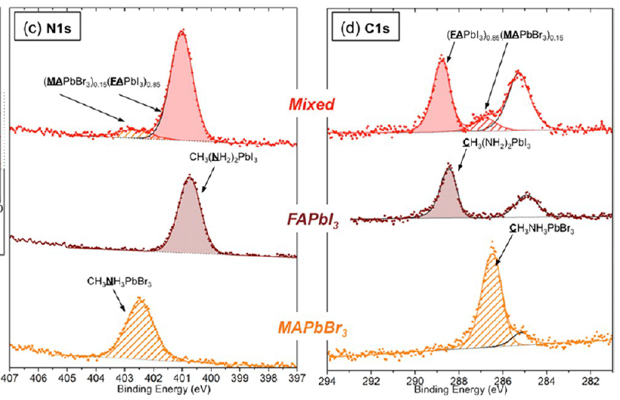
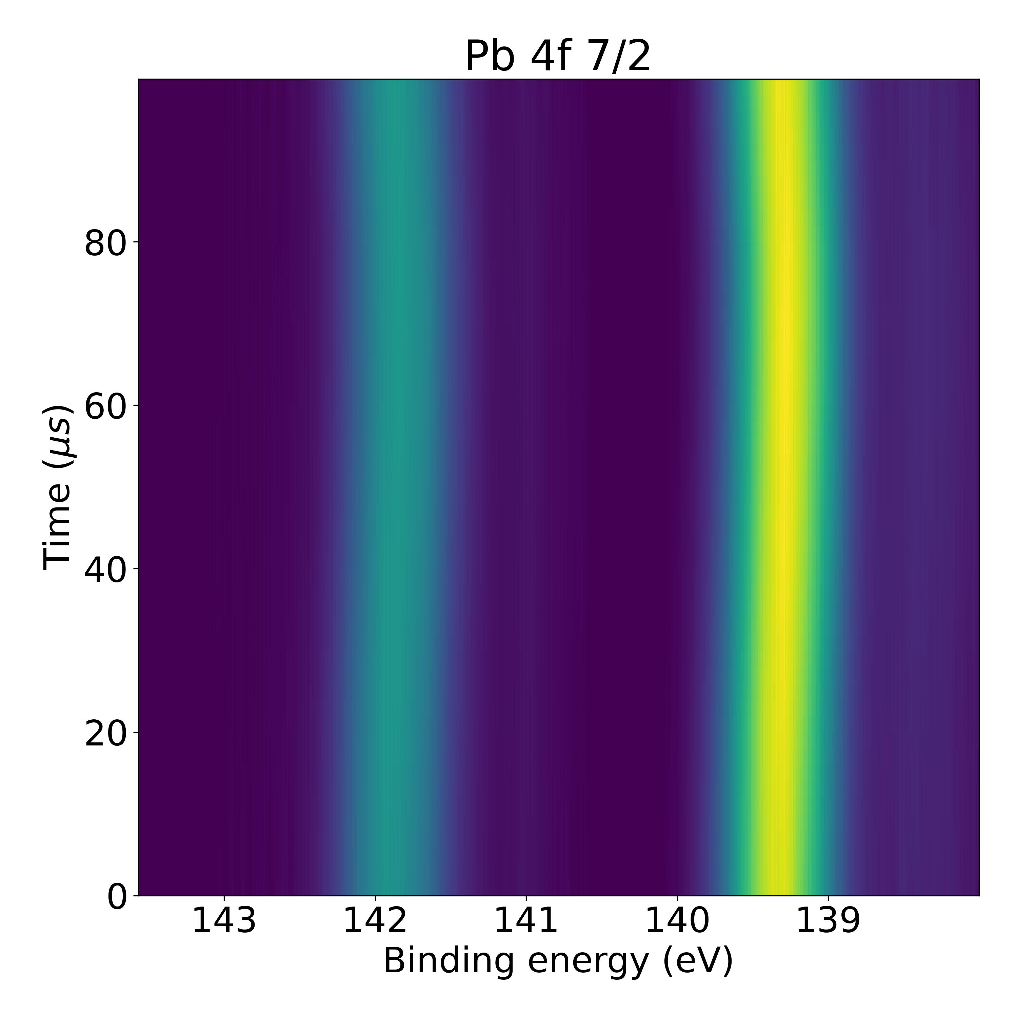
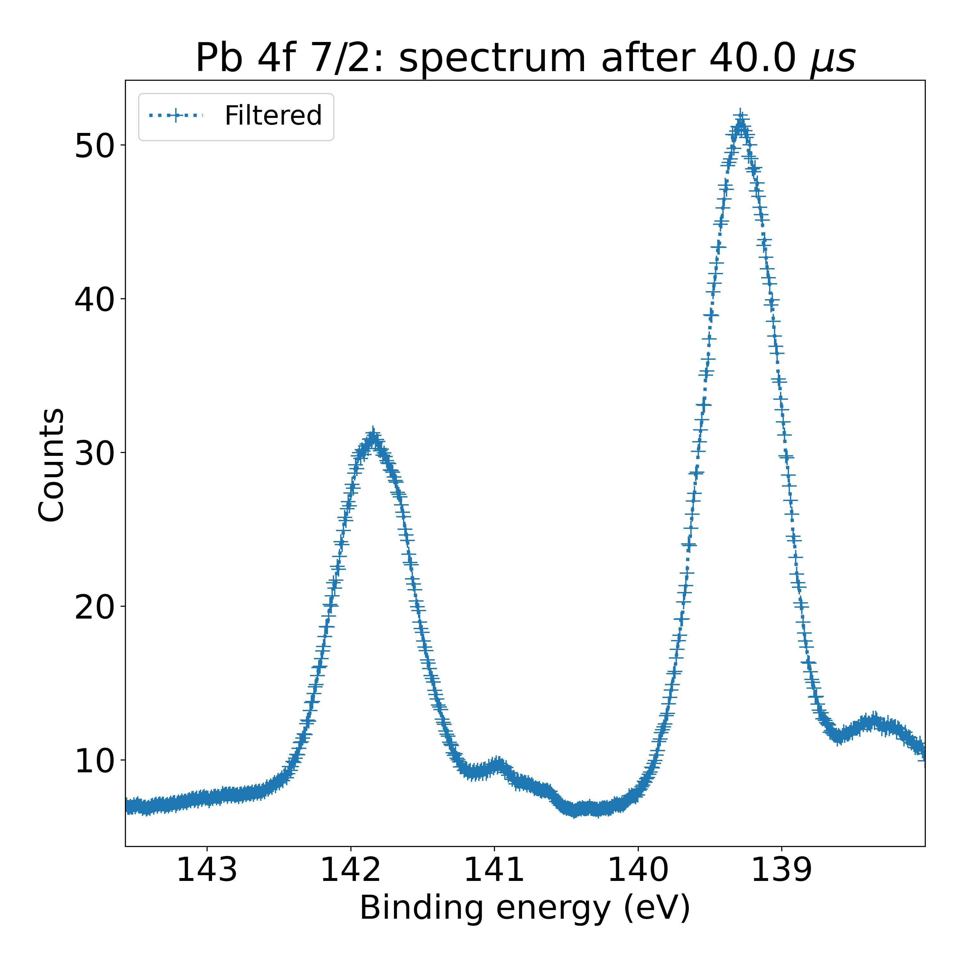
Objective: high throughput fits of XPS spectra
Fitting procedure must allow to distinguish peak contributions in XPS spectra
TR-XPS measurements: high throughput analysis methods are necessary
Two different contributions in mixed composition
Two different chemical environments for nitrogen atoms
1000 spectra to analyze
Jacobsson, T. J., Correa-Baena, J. P., Halvani Anaraki, E., Philippe, B., Stranks, S. D., Bouduban, M. E. F., Tress, W., Schenk, K., Teuscher, J., Moser, J. E., Rensmo, H., & Hagfeldt, A. (2016). Unreacted PbI2 as a Double-Edged Sword for Enhancing the Performance of Perovskite Solar Cells. Journal of the American Chemical Society, 138(32), 10331–10343.

Slide 3

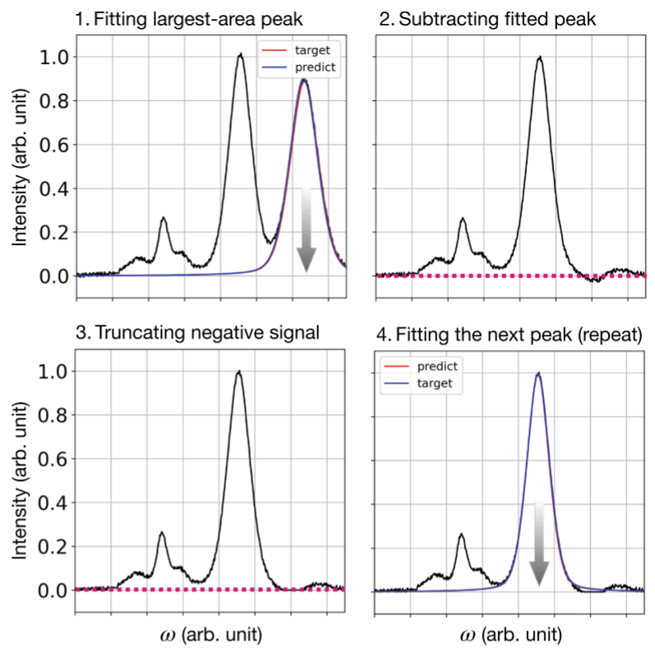
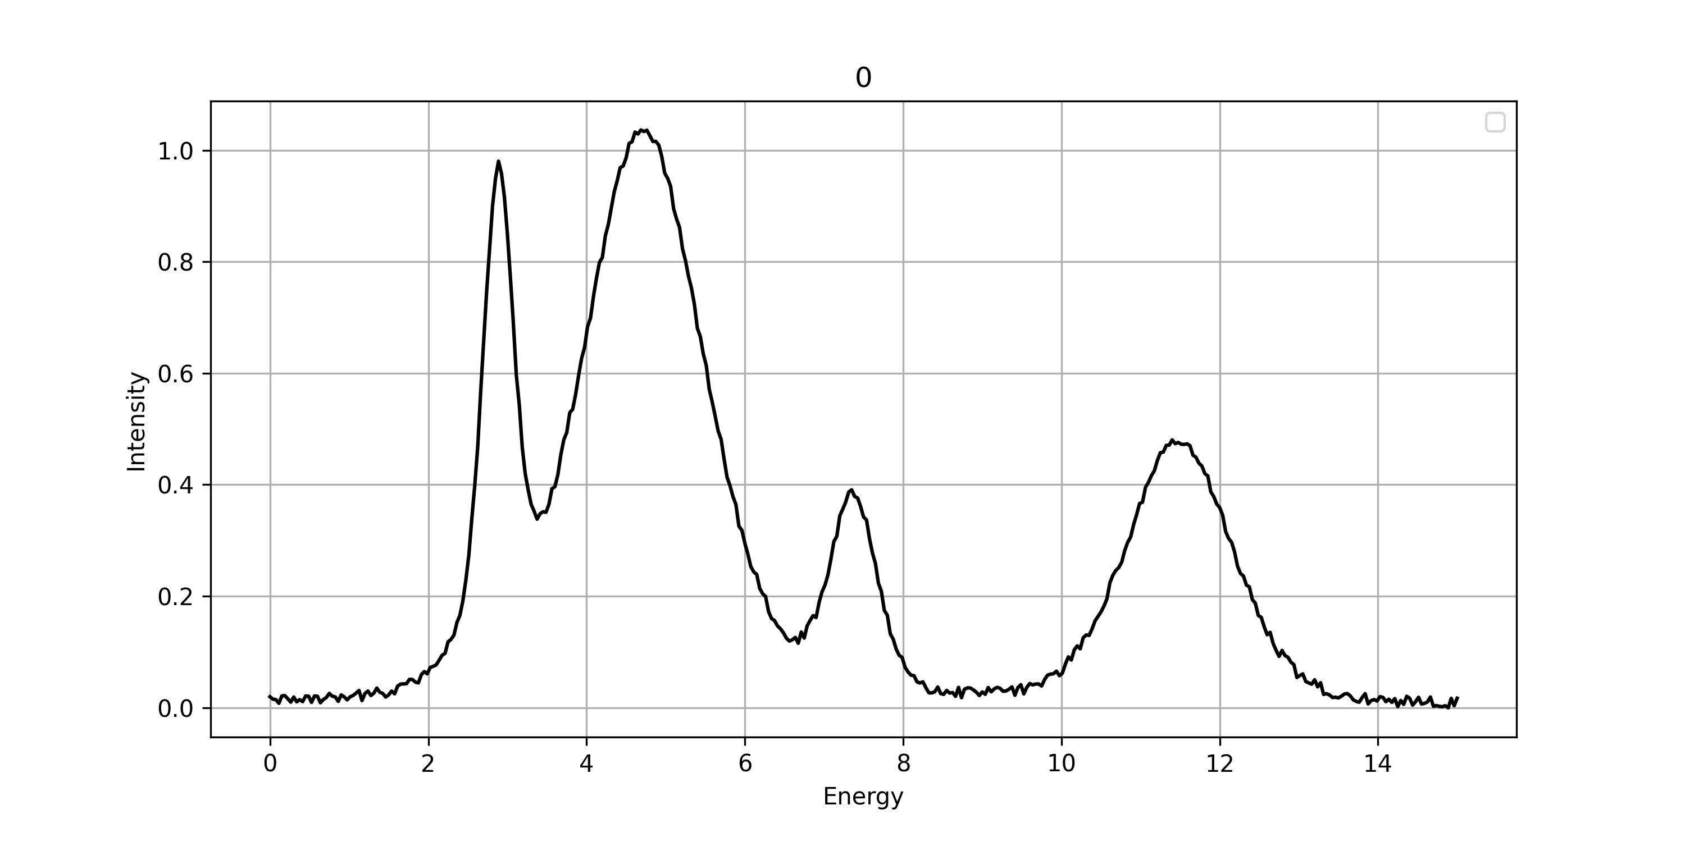
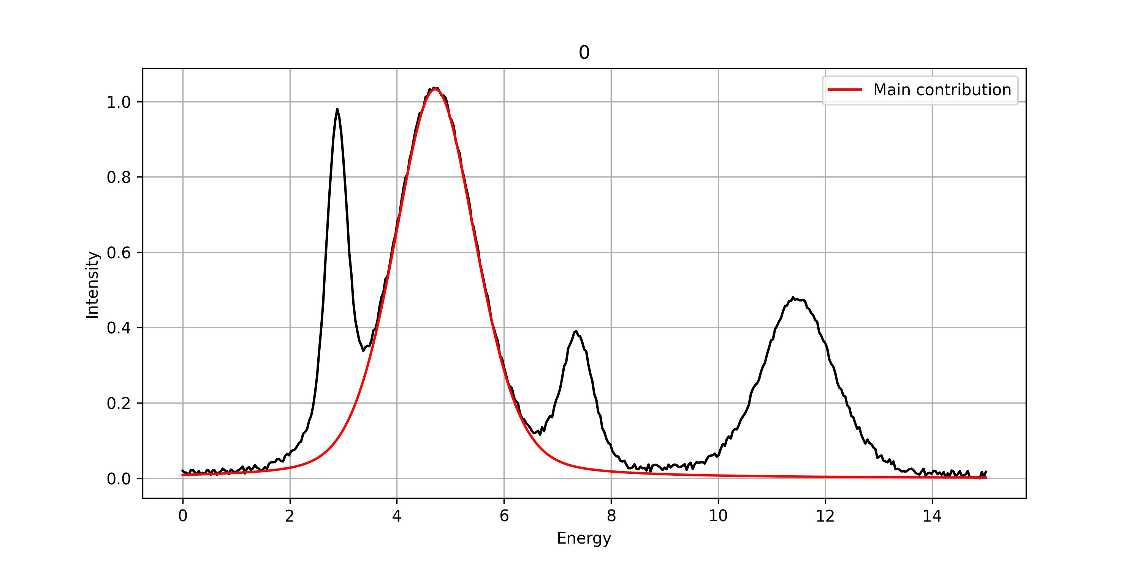
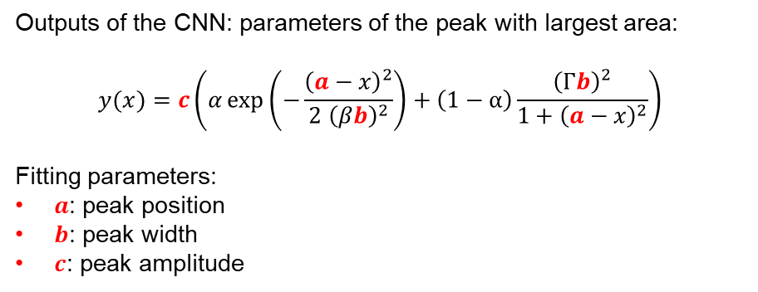

Convolutional neural networks for iterative identification of major peak
Convolution neural networks: serial connection of convolution products and filters
Principle of the procedure: iterative identification of $a$, $b$ and $c$ for each peak contribution.
Outputs of the CNN: parameters of the peak with largest area:
$$y(x)=c\left(α\exp\left(−\frac{{\left(a−x\right)}^{2}}{2{ \left(βb\right)}^{2}}\right)+\left(1−α\right)\frac{{\left(Γb\right)}^{2}}{1+{\left(a−x\right)}^{2}}\right)$$
Fitting parameters:
$a$: peak position
$b$: peak width
$c$: peak amplitude
Park, S. H., Park, H., Lee, H., & Kim, H. S. (2021). Iterative peak-fitting of frequency-domain data via deep convolution neural networks. Journal of the Korean Physical Society, 79(12), 1199–1208.

Slide 4
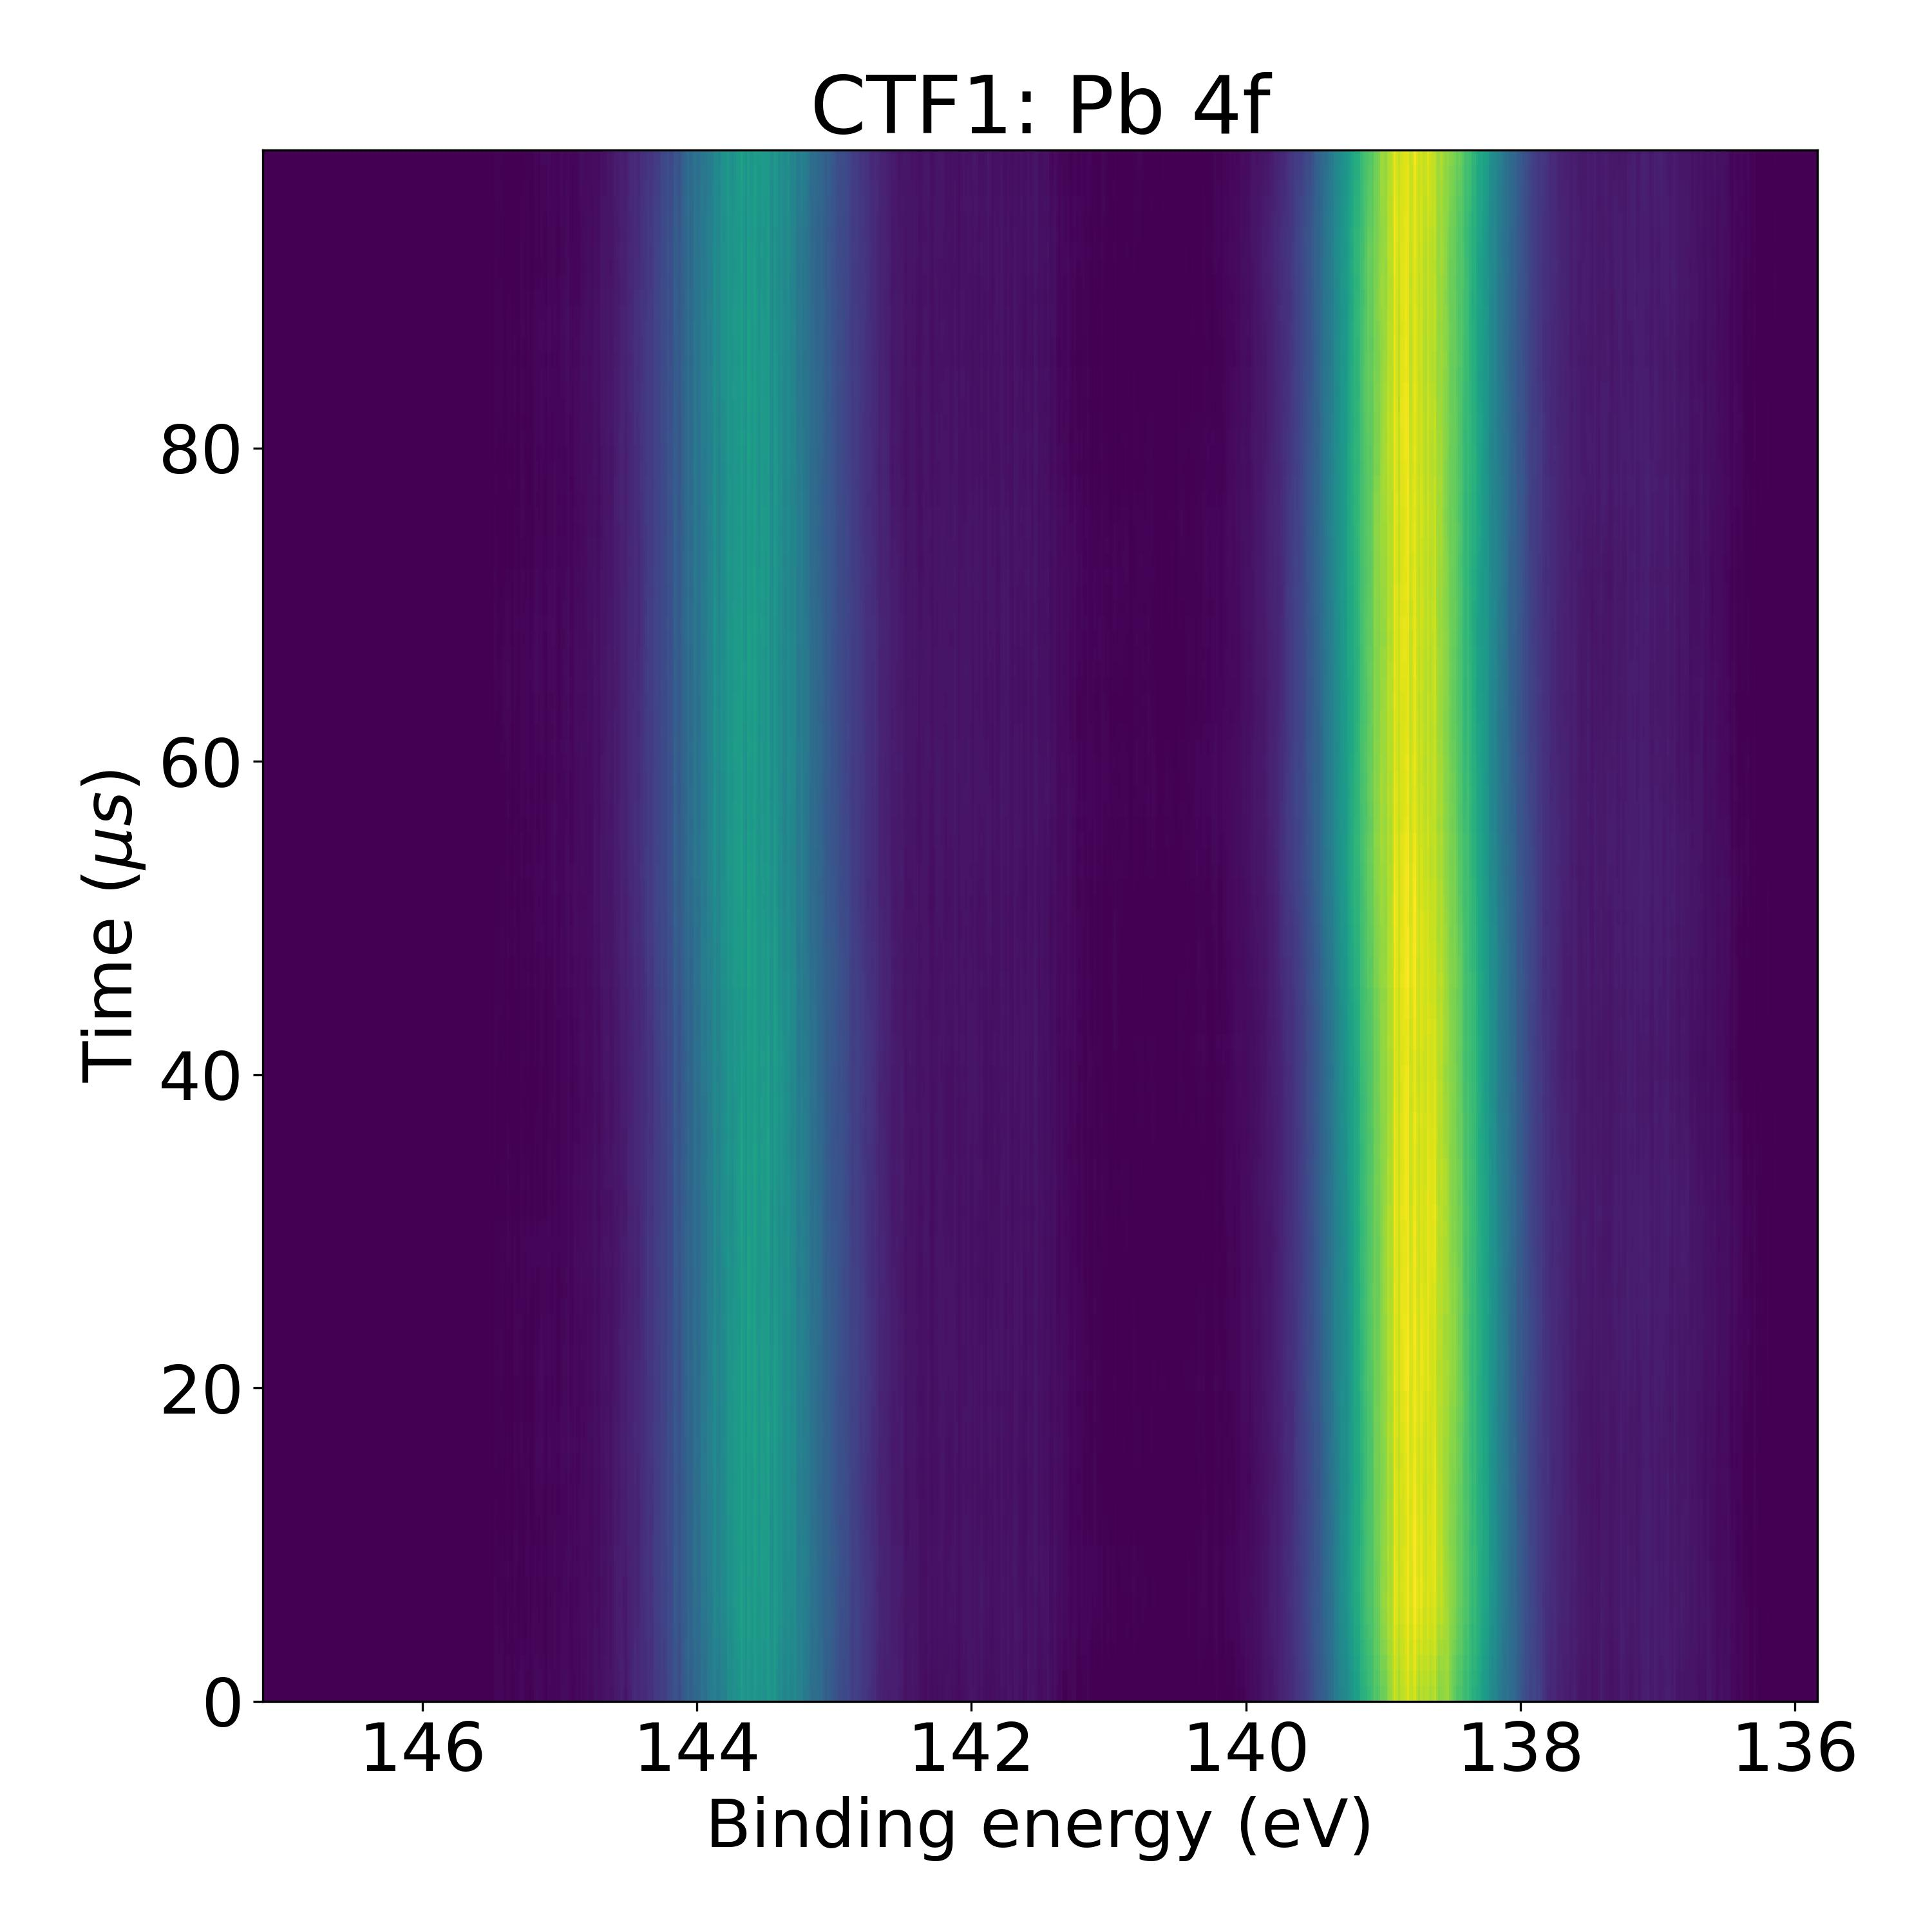
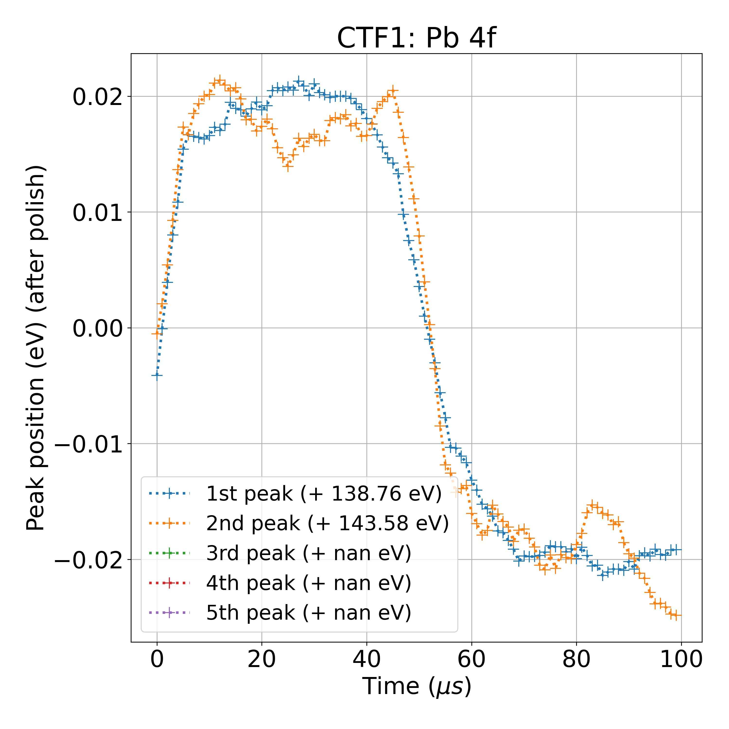
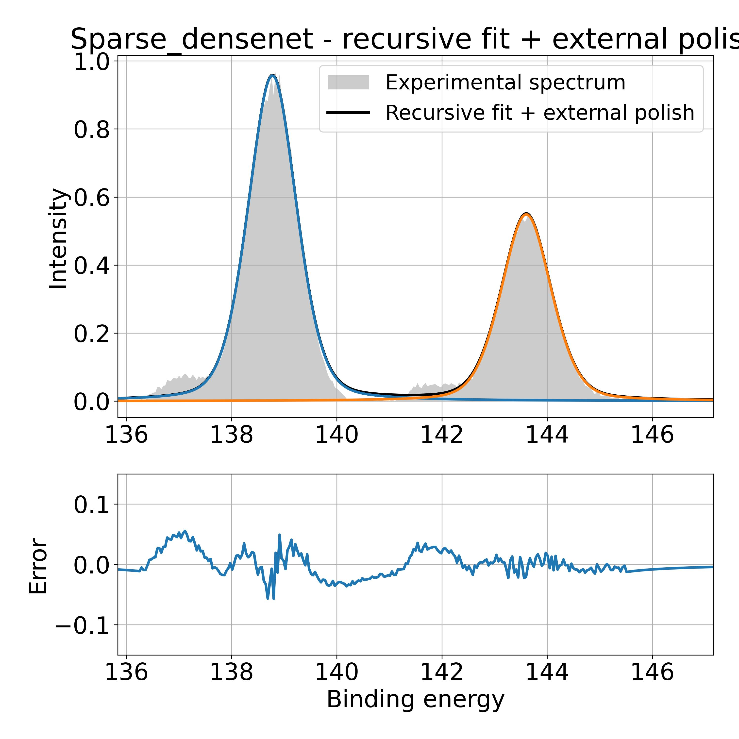
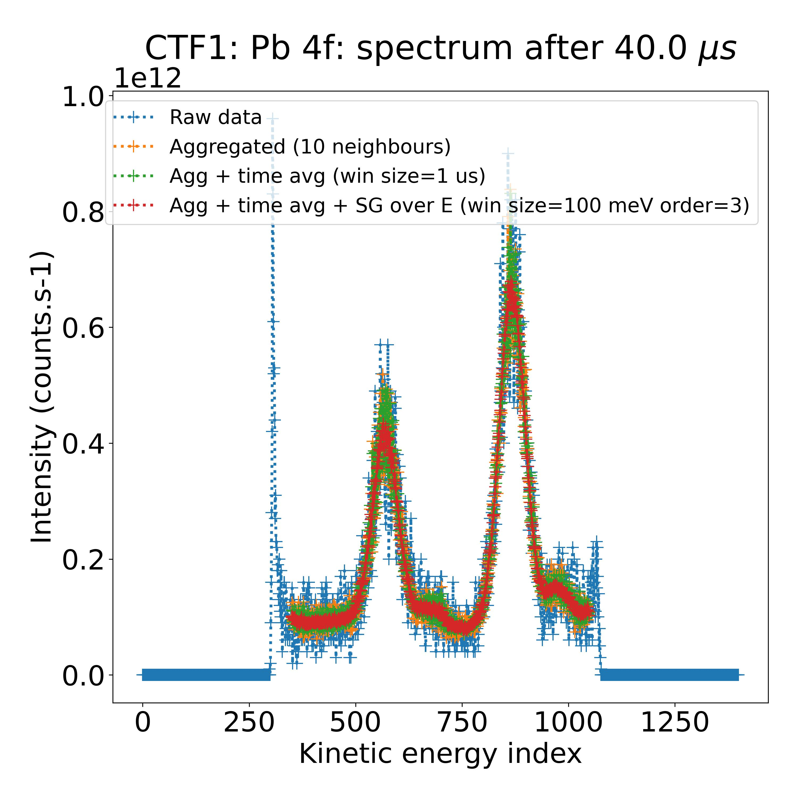
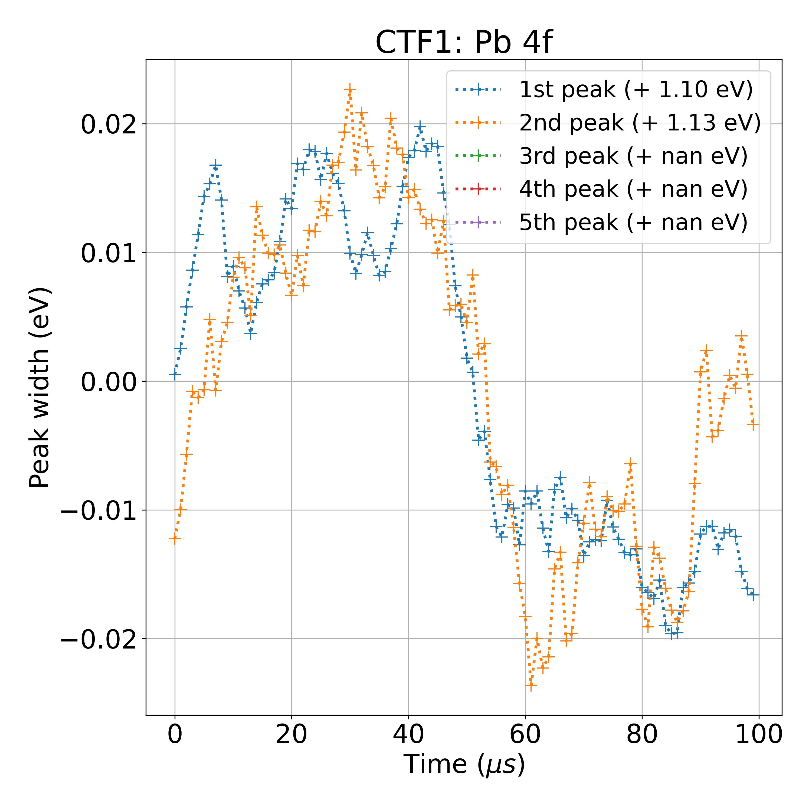
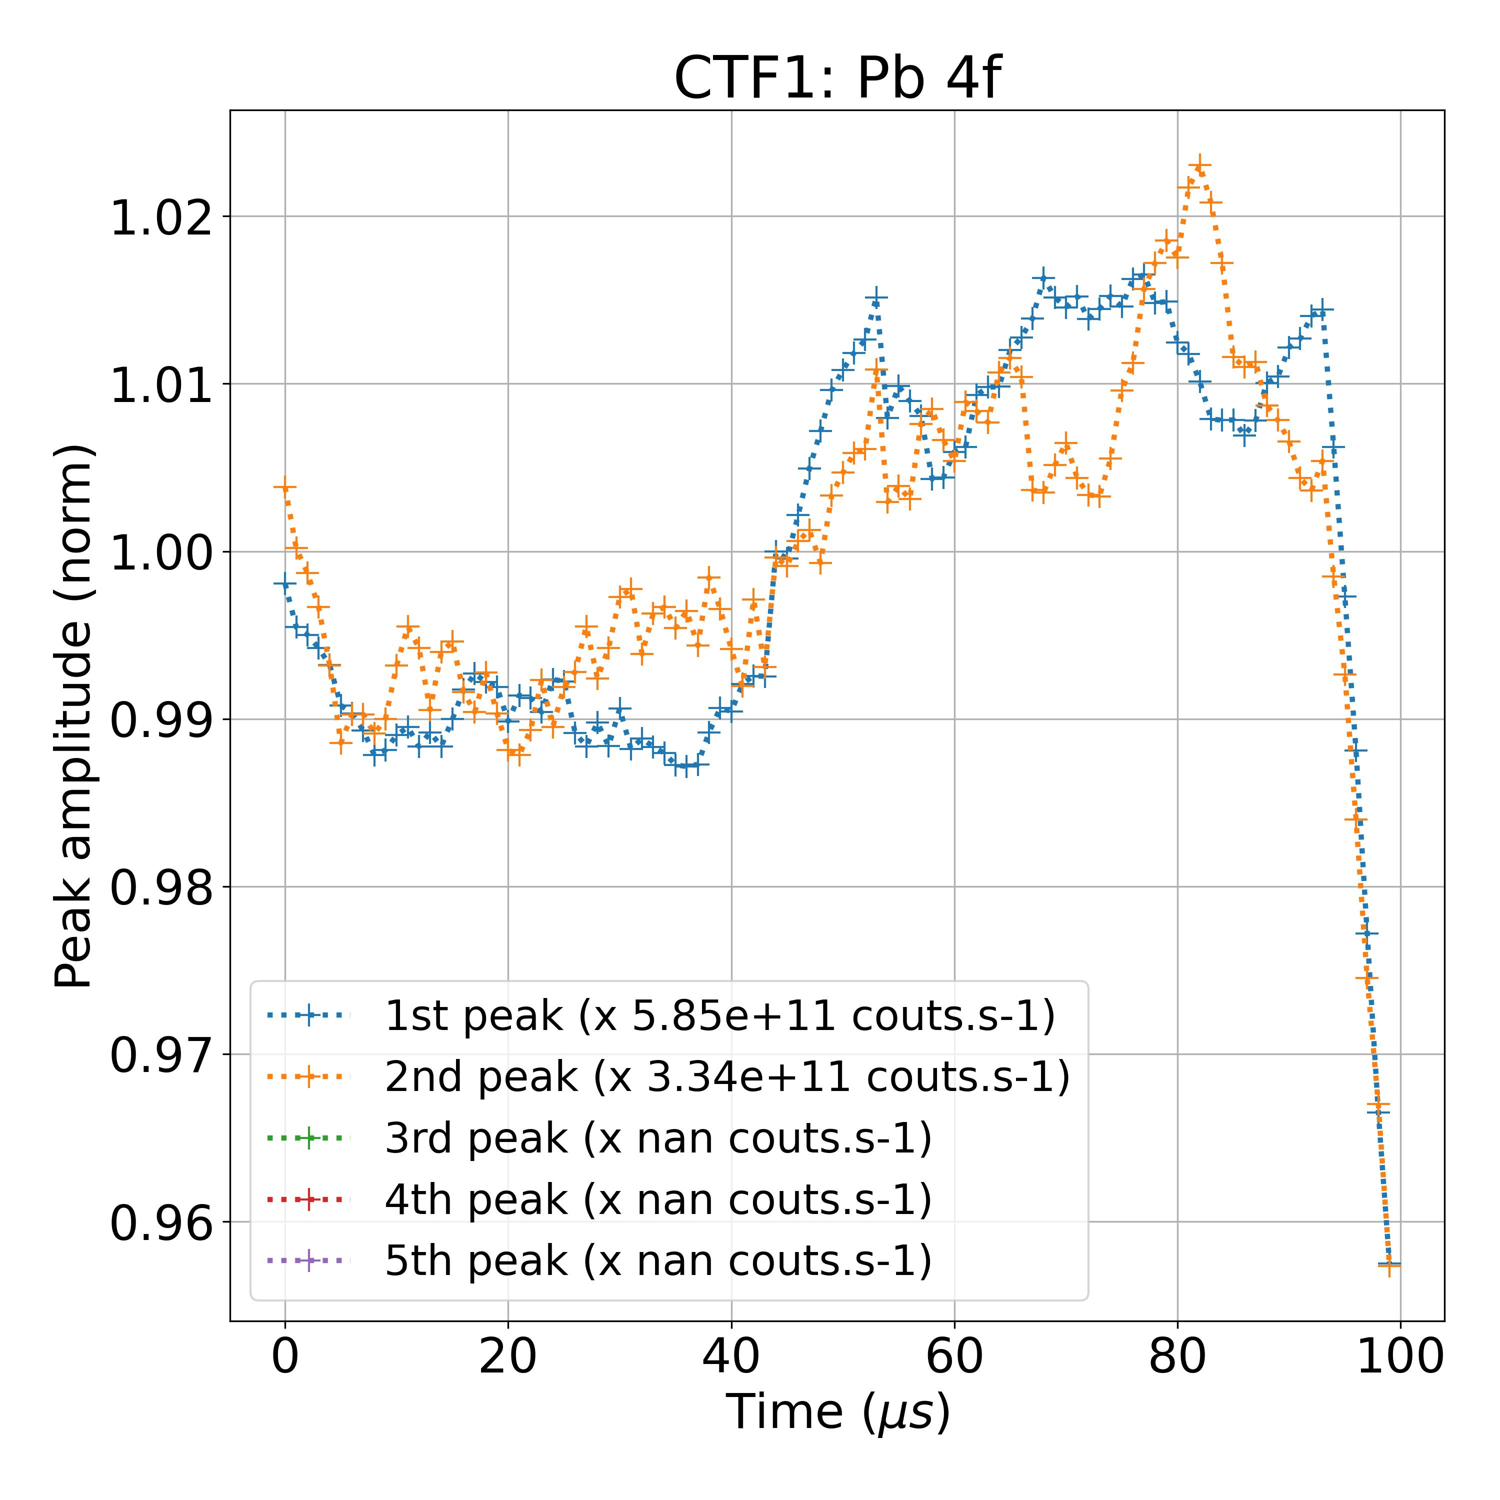
Results on experimental TR-XPS measurements
Total fit time (100 spectra): 43 sec
4f 7/2
Laser off
Laser on
4f 5/2
Filtering noisy experimental data
(eV)

Slide 5
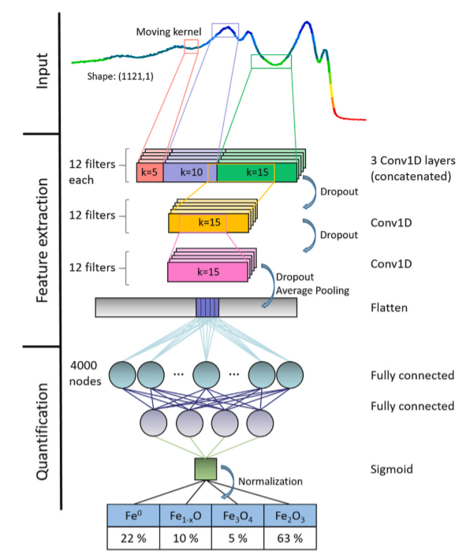
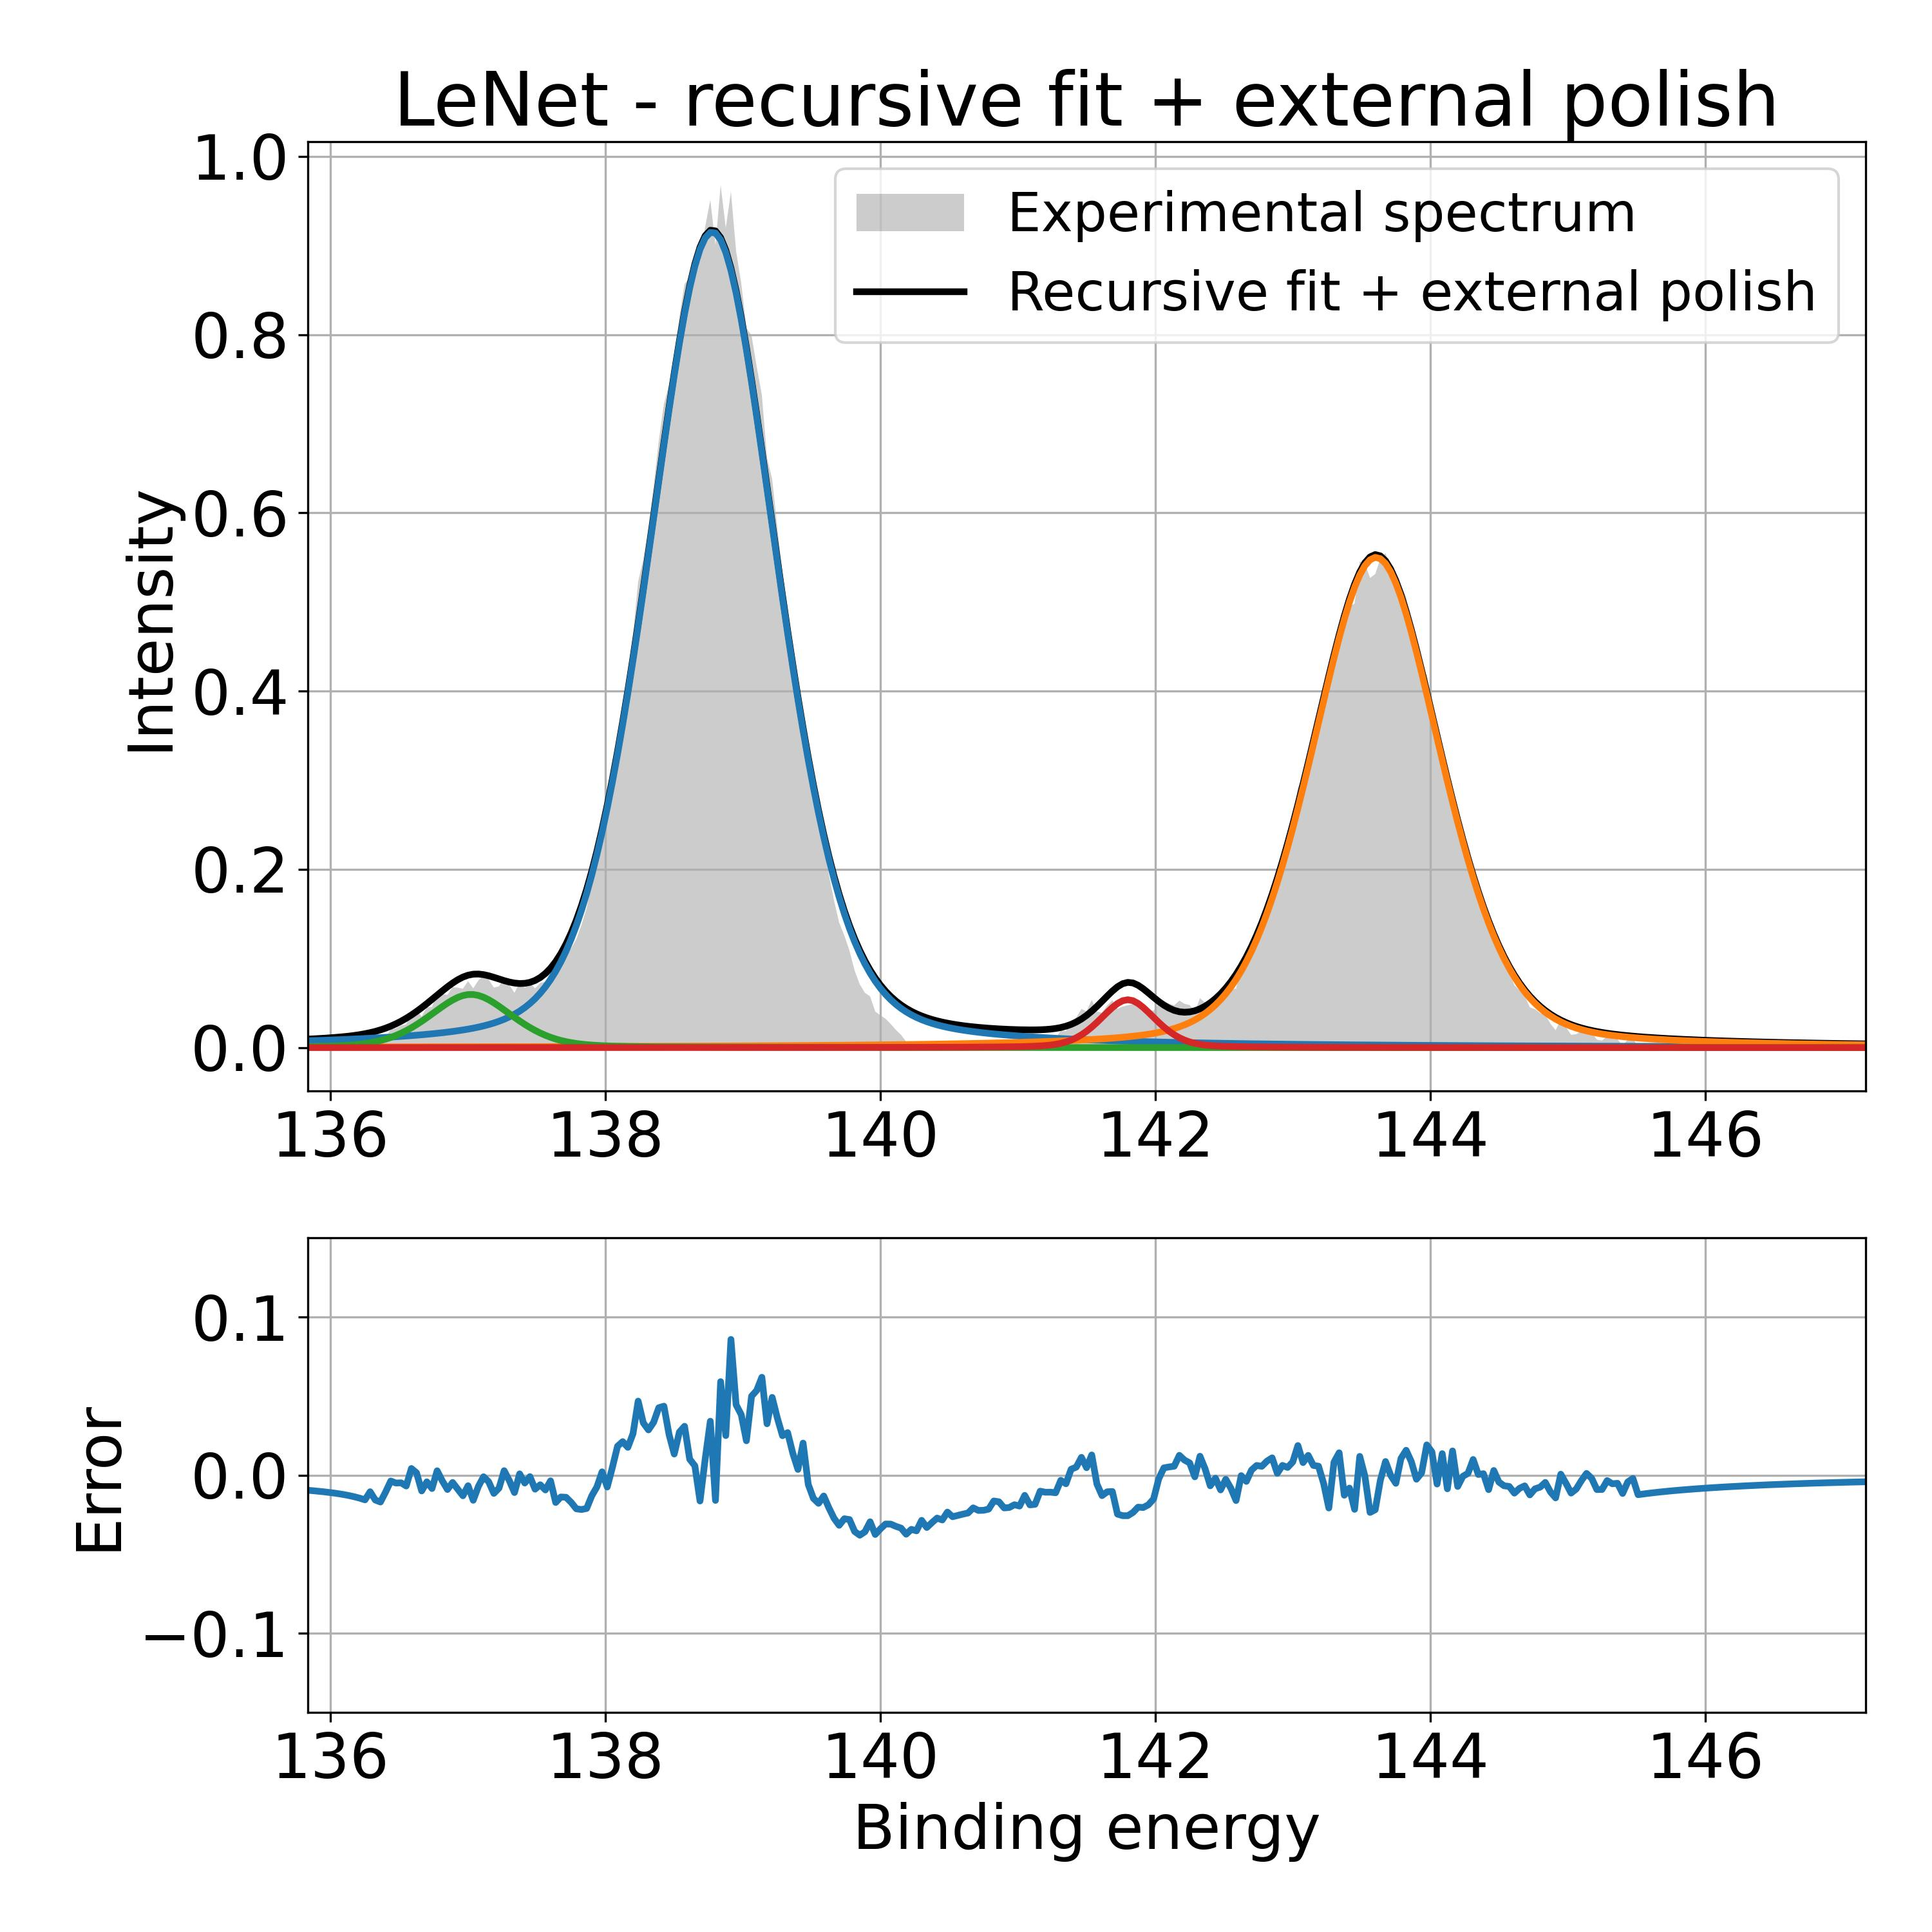
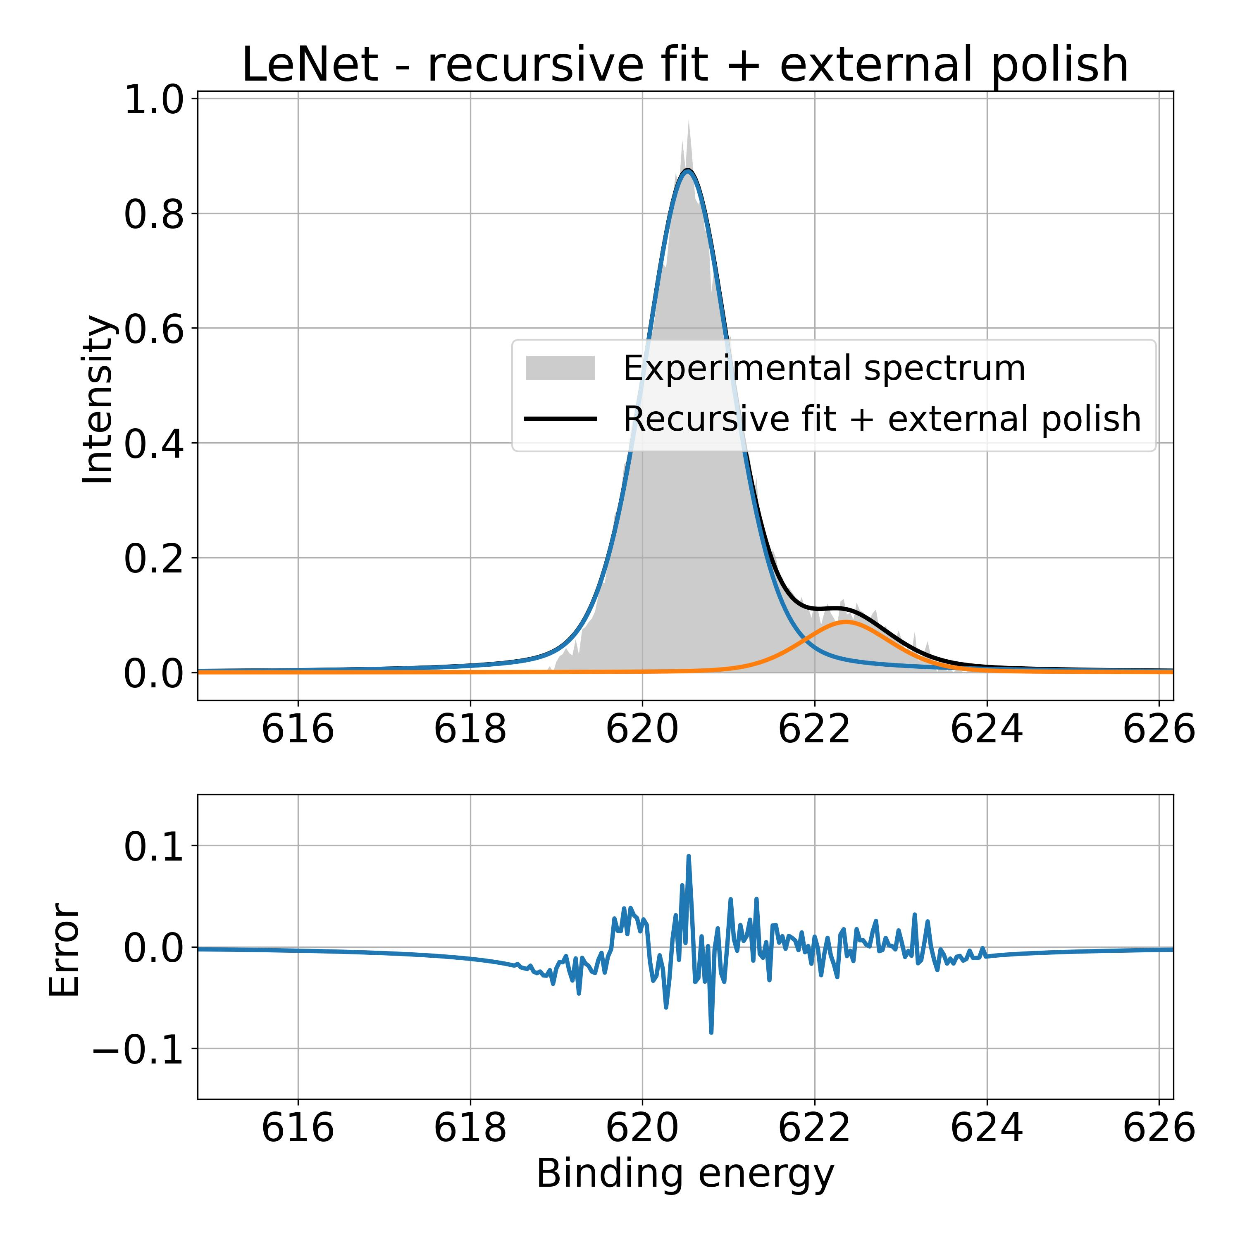
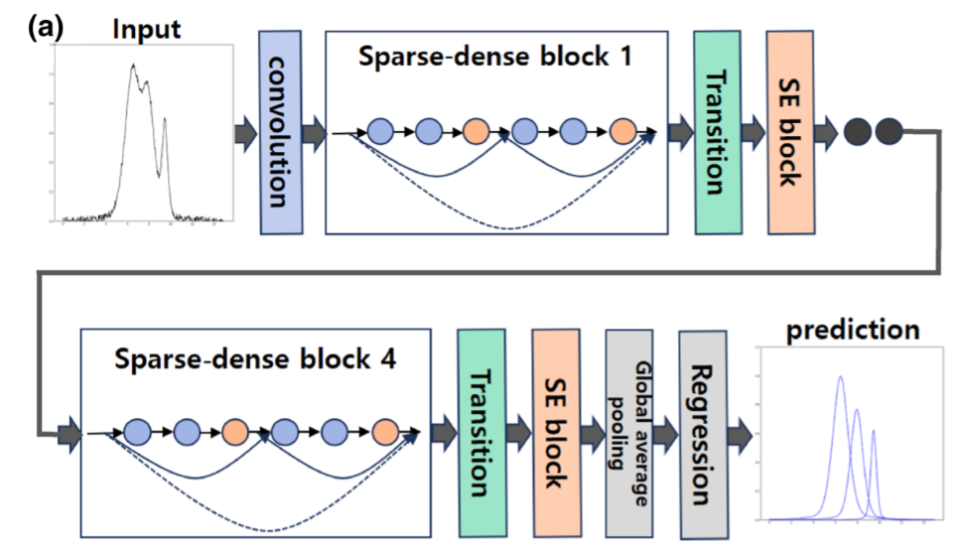
Perspectives
Combine existing / develop new architectures
Possibility to track supplementary smaller contributions:
Pb 4f
I 3d 5/2
(eV)
(eV)
Adapt models and training to specific peaks identifications
Directly detect several peaks (vs iterative approach)
Detect pairs of 5/2 – 7/2 peaks
Pielsticker, L., Nicholls, R. L., DeBeer, S., & Greiner, M. (2023). Convolutional neural network framework for the automated analysis of transition metal X-ray photoelectron spectra. Analytica Chimica Acta, 1271.
Park, S. H., Park, H., Lee, H., & Kim, H. S. (2021). Iterative peak-fitting of frequency-domain data via deep convolution neural networks. Journal of the Korean Physical Society, 79(12), 1199–1208.

